Slide 1
Java Generics
Shoham E

Slide 2
Generics
Java Generics were introduced in JDK 5.0
It aims to reduce bugs, increases type safety and add an extra layer of abstraction over types.
Compiler only feature (no JRE involved)
Can be used within methods, classes, interfaces
Commonly used in Collection framework of java.util

Slide 3
what we had before Generics
Let’s have a list of Integers:
List list = new LinkedList();
list.add(new Integer(1));
Integer num = list.iterator().next(); // doesn’t compile, since compiler has no type information of List’s residents (holds Objects), and actually there is no guarantee that the type inserted is indeed Integer.
In order for this to compile we would use cast (from Object into Integer)
Integer num = (Integer) list.iterator().next(); // compiles but annoys and makes code messy
Adding cast all over is actually annoying, code cluttering and much worse is the probability of causing TypeCastException on RT! If the developer makes a mistake (But what are the odds for that??)
String str = (String) list.iterator().next(); // java.lang.ClassCastException

Slide 4
the solution - Generics
Let’s modify the example so that we give the compiler explicitly our intension:
List<Integer> list = new LinkedList<>();
list.add(new Integer(1));
Integer num = list.iterator().next();
This was the usage. The definition is as follows
public interface List<E> extends Collection<E> {
…
}

Slide 5
Generics – Behind the scenes
The Generics is a compile-time feature. The compiler removes the type parameters and uses Object instead
* Therefore -> primitive types can’t be used as type parameters (at least till java 9)
User types |  | Compiler translates (bytecode)
boolean add(T t); | → | boolean add(Object t);
List<Integer> list = new ArrayList<>(); list.add(17); int first = list.get(0); | → | List list = new ArrayList() list.add(Integer.valueOf(17) ); int first = ((Integer) list.get(0)).intValue();

Slide 6
Common Standard
T for type
K for key
V for Value
E - Element (used extensively by the Java Collections Framework)
N - Number

Slide 7
Generic Class/interface
public interface Comparable<T> {
public int compareTo(T o);
}
public class MessageHolder<T> {
private T message;
public T getMessage(){
return “Hello “ + this.t;
}
public void setMessage(T t1){
this.t = t1;
}
}

Slide 8
Generic methods
Generic methods have a type parameter before the return type of the method declaration <T>
Generic methods can have different type parameters separated by commas in the method signature <T, G>
Method body for a generic method is just like a normal method
Example – converting array to list:
public <T> List<T> fromArrayToList(T[] a) {
return Arrays.stream(a).collect(Collectors.toList());
}
@Test
public void test() {
Integer[] intArray = {1, 2, 3, 4, 5};
List<Integer> stringList = fromArrayToList(intArray);
}

Slide 9
Bounded/restricted Generics
Upper bound
public <T extends Number> List<T> fromArrayToList(T[] a) {
...
}
fromArrayToList(new Integer[2]); // compiles fromArrayToList(new String[2]); // doesn’t compile fromArrayToList(new Number[2]); // compiles fromArrayToList(null); // compiles
Multiple bounds
<T extends Number & Comparable>

Slide 10
Wildcards
Uses ?
Represents unknown type (not interesting)
Used in parameter type, field
Not used in return value, type argument, generic class instance creation, or a supertype.

Slide 11
Bounded/restricted Wildcards
Unbounded
public static void printList(List<?> list) // when using Object’s functionality or doesn’t use type’s functionality like List.size
Upper bound
List<? extends Shape> shapes = getAllShapes();
shapes.add(new Rectangle()); // compiles shapes.add(new Color()); // doesn’t compile shapes.add(new Shape()); // compiles shapes.add(null); // compiles
Lower bound
List<? super Integer> numbers1 = new ArrayList<Integer>();
List<? super Integer> numbers2 = new ArrayList<Number>();
List<? super Integer> numbers3 = new ArrayList<Object>();
List<? super Integer> numbers4 = new ArrayList<String>();

Slide 12
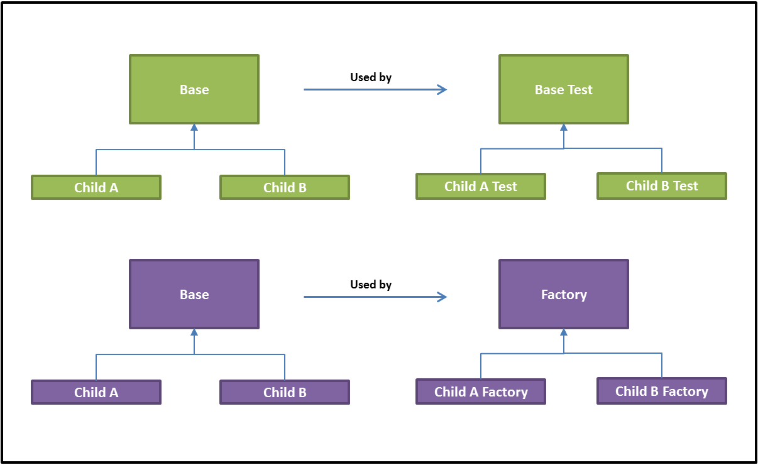
When to use it
Replace casting or Object uses
Data structures (collections are example, ValidationSegmentStatus)
When you provide an class implementing a general logic, unrelated to a specific type (like CollectionUtils)
When you already have types hierarchy and wants to add dedicated functionality for those types (RequestUnitFieldsFactory)

Slide 13
Homework time
Find places in the automation code that can be improved by using generics.
Hint - look for code which uses:
Casting
Object
Duplicates of similar data structures
Classes which handles specific data types
Duplicates of logics
When you have an interface and implementors. and a class which uses only interface methods
….

Slide 14
Thank You

